Slide 1
Stability of Differential Equations
By: Erica Wang
9/26/2021

Slide 2
What is Differential Equation Stability
A differential equation is said to have stability when, for any initial conditions, the solutions of the equation are bounded.
A differential equation is said to have asymptotic stability when, for any initial conditions, the solutions of the equation are bounded AND eventually approach zero.
The initial conditions of the equation do not especially effect the end behavior.

Slide 3
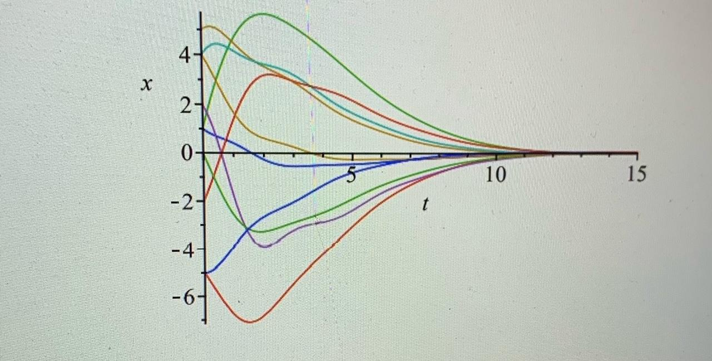
Example Graph of Asymptotically Stable Equation

Slide 4
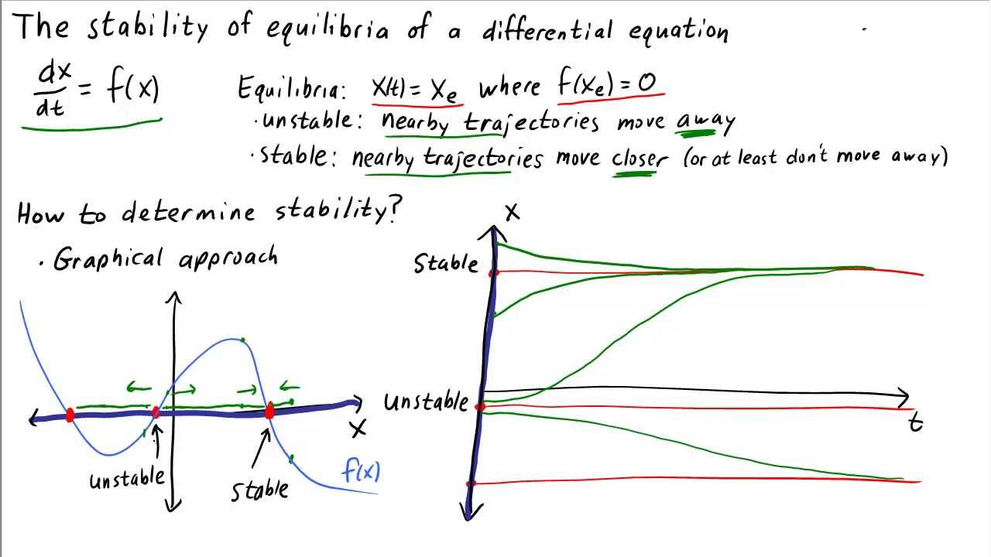
Unstable Equations
An unstable equation is not stable. The solutions, or trajectories, move away from each other rather than approaching zero.

Slide 5
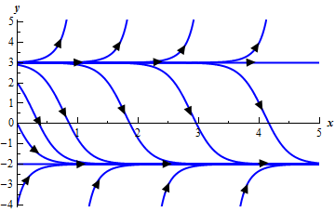
Unstable Equations
The top of the graph depicts an unstable differential equation.
The bottom of the graph depicts a stable equation.
The stable equation is not asymptotically stable since the solutions approach y=-2 rather than y=0.

Slide 6
Importance/use of differential equation stability
The stability of equations is used very widely in real-world problems and has significant effects in nearly all situations involving equations.
When using a mathematical model to model a physical problem, there will always be error, whether it be human error, instrument error, or random error.
Therefore, there will be slight deviations from the mathematical model and thus the equation.
If the equation were unstable, such minor deviations in the initial conditions would result in large variation in solutions, which would compromise the ability of the mathematical model to accurately predict the outcomes of the problems.
To be able to safely and accurately use mathematical models, the equations must be stable.

Slide 7
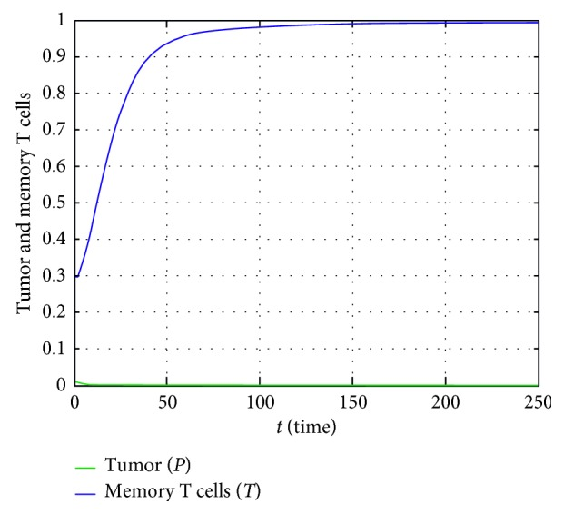
Example of Mathematical Models
Here, we model the dynamics between pathogen and immune system cells, also known as memory T cells.

Slide 8
Routh-Hurwitz Criterion
The Routh-Hurwitz stability criterion is a statement determining whether or not an equation is stable.
According to the Routh-Hurwitz stability criterion, any equation or system can be stable if and only if all the roots of the first column have the same sign. If the roots of the first column do not all have the same sign or if there is a sign change, then the number of sign changes in the first column is equal to the number of roots of the equation with positive real parts.

Slide 9
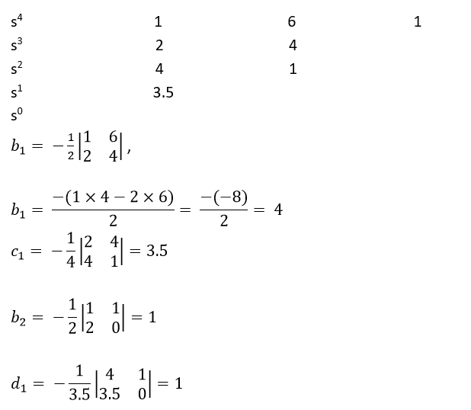
Routh-Hurwitz Criterion
The Routh-Hurwitz Criterion provides a shortcut to determine whether or not an equation is stable.
With the Routh-Hurwitz Criterion, you no longer need to solve the equation to find the stability of the equation.

Slide 10
Routh-Hurwitz Criterion
Unfortunately, there are some drawbacks to the Routh-Hurwitz Criterion.
First, the criterion is only applicable for a linear system.
Second and most importantly, the calculation of the stability of an equation using the Routh-Hurwitz Criterion is inefficient and takes too much time by hand.
Therefore, I have written Maple procedures to demonstrate the stability of differential equations and systems of differential equations in a time-friendly and cost-efficient way.

Slide 11
Maple Procedures
Here, I use the powerful Maple function dsolve-numeric to write the procedures to calculate the stability of differential equations or systems of differential equations.
First, many conditions are picked up randomly.
Those initial value problems are then solved and solutions are graphed on the same graph.

Slide 12
Maple Procedures
Each different-colored line represents a different initial condition. As you can see, all lines taper to zero, indicating that the equation is asymptotically stable.
The method is based on numerical approach, so the equation can be either linear or nonlinear.

Slide 13
Maple Procedures
We may run the procedure many times. If all the solutions approach zero, we can believe that the equation is asymptotically stable.
This is not a theoretical proof. It can be used as verifications or to get an idea about the stability of an equation.
It can also be useful for teaching and learning differential equations of system theory.
I have written two procedures. One is for stability of differential equations, and the other procedure is for stability of systems of equations.

Slide 14
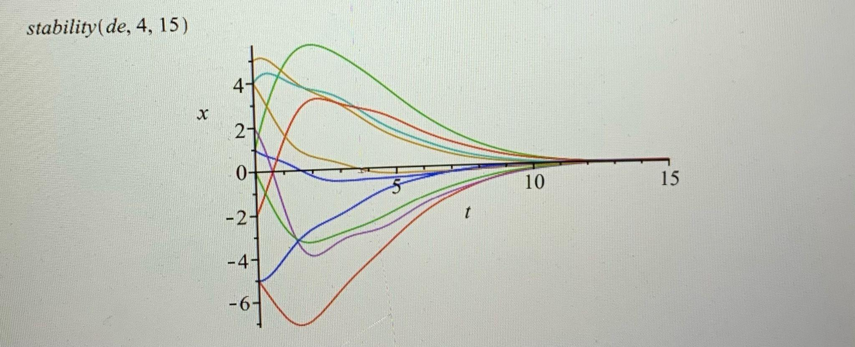
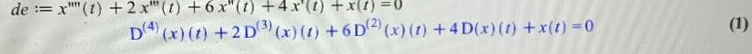
Example
The name of the procedure is Stability.
The first argument of the procedure is de.
The second argument of the procedure is the equation.
The third argument is the range of the independent variable.

Slide 15
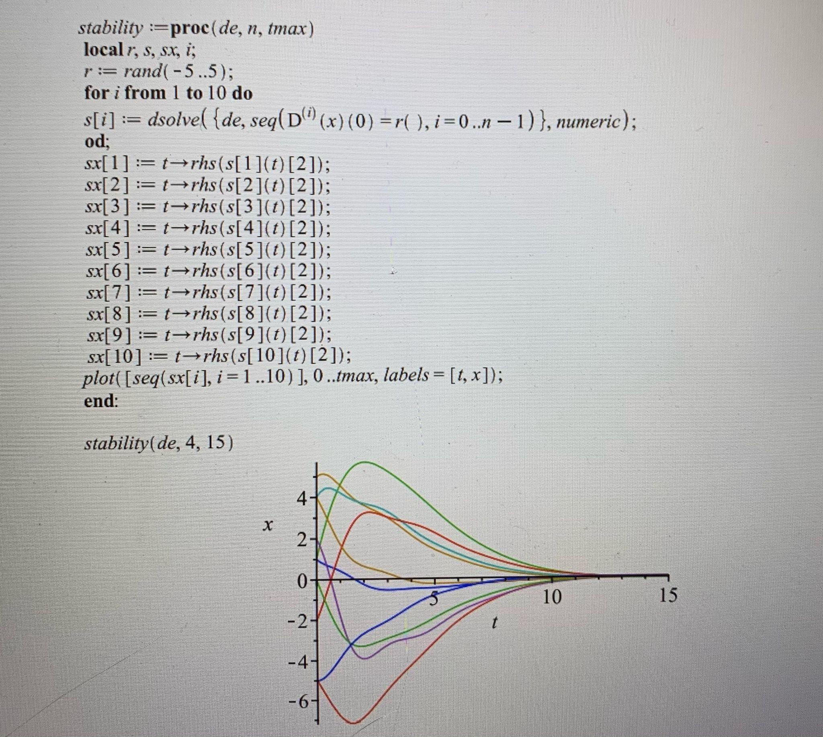
Example
This procedure shows graphs of a differential equation with many random initial conditions. The first argument is a differential equation, the second argument is the order of the differential equation, and the third argument is the range of the graphs.

